Slide 1



TEAM NAME : KITTLER
DeMod
A decentralised moderation solution

Slide 2
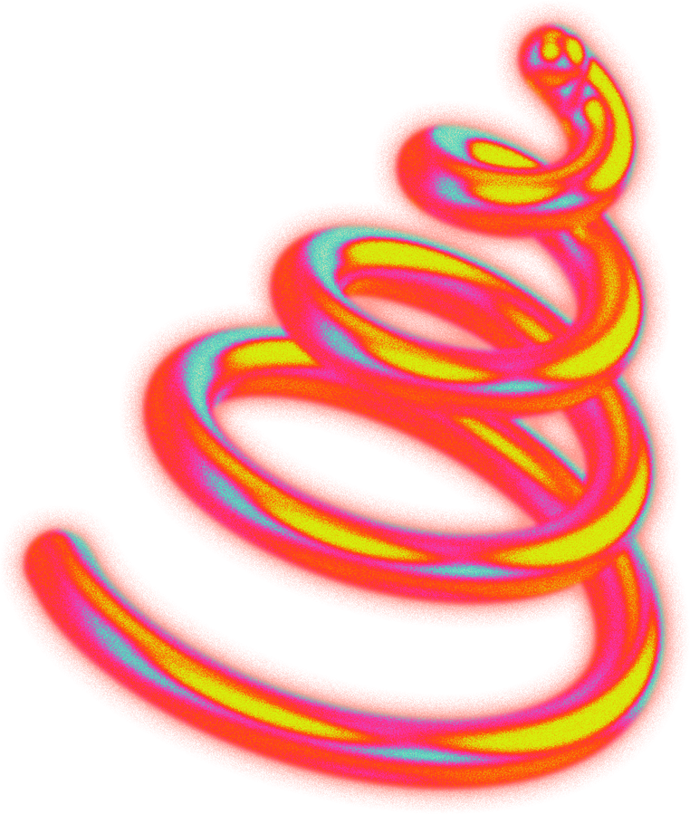
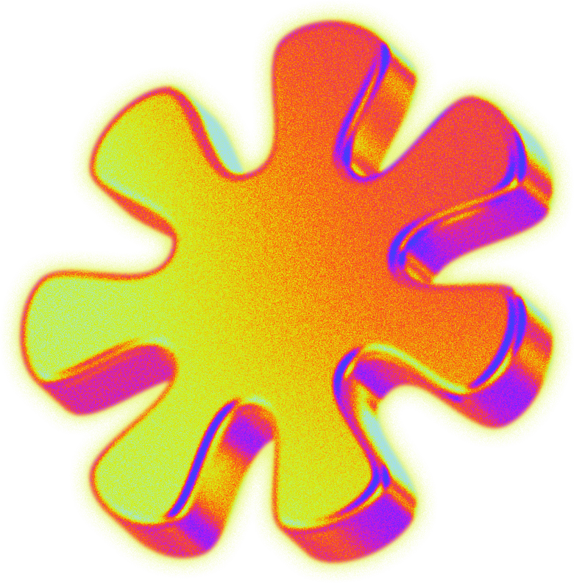
THE
INTRODUCTION
With the surge in social media users and User Generated Content(UGC), moderation needs growth, but hiring and paying moderators is costly.
Decentralized Moderation (Demod) utilizes blockchain technology for enhancing transparency and fairness.
Enables a community-driven approach (reddit for example), allowing users to participate directly in the moderation process, which democratizes content governance.

Slide 3
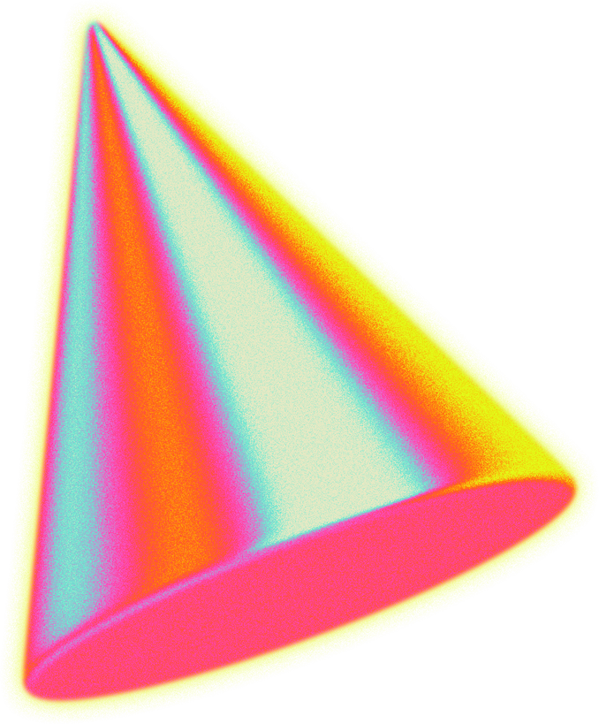
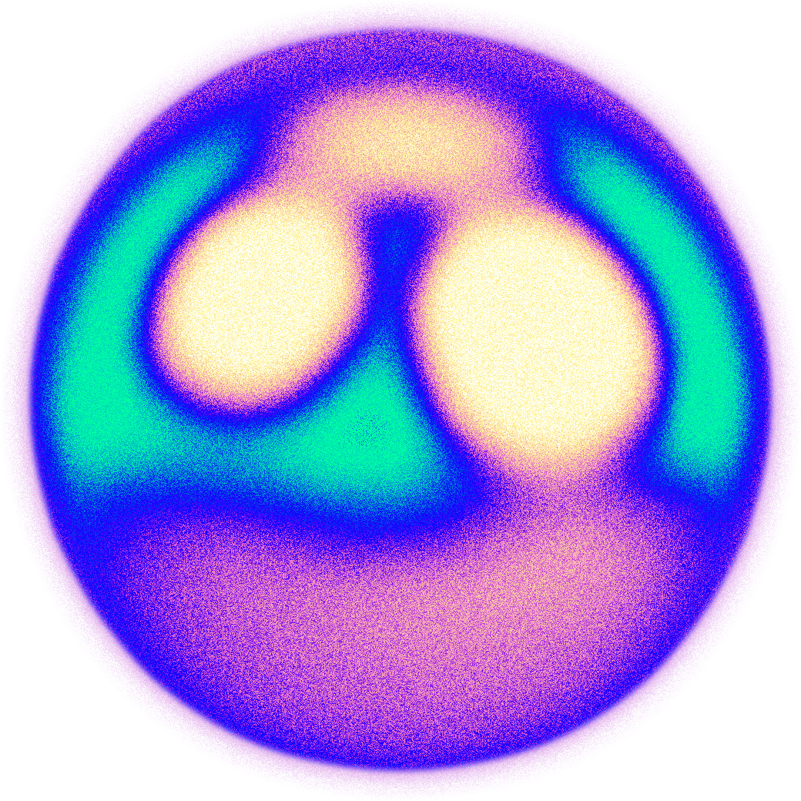
Aims to create a safer, more equitable digital environment by balancing freedom of expression with robust safeguards against harmful content.
The global content moderation solutions market was valued at USD 9.02 billion in 2022. This stands as proof of marketablity of DeMod

Slide 4
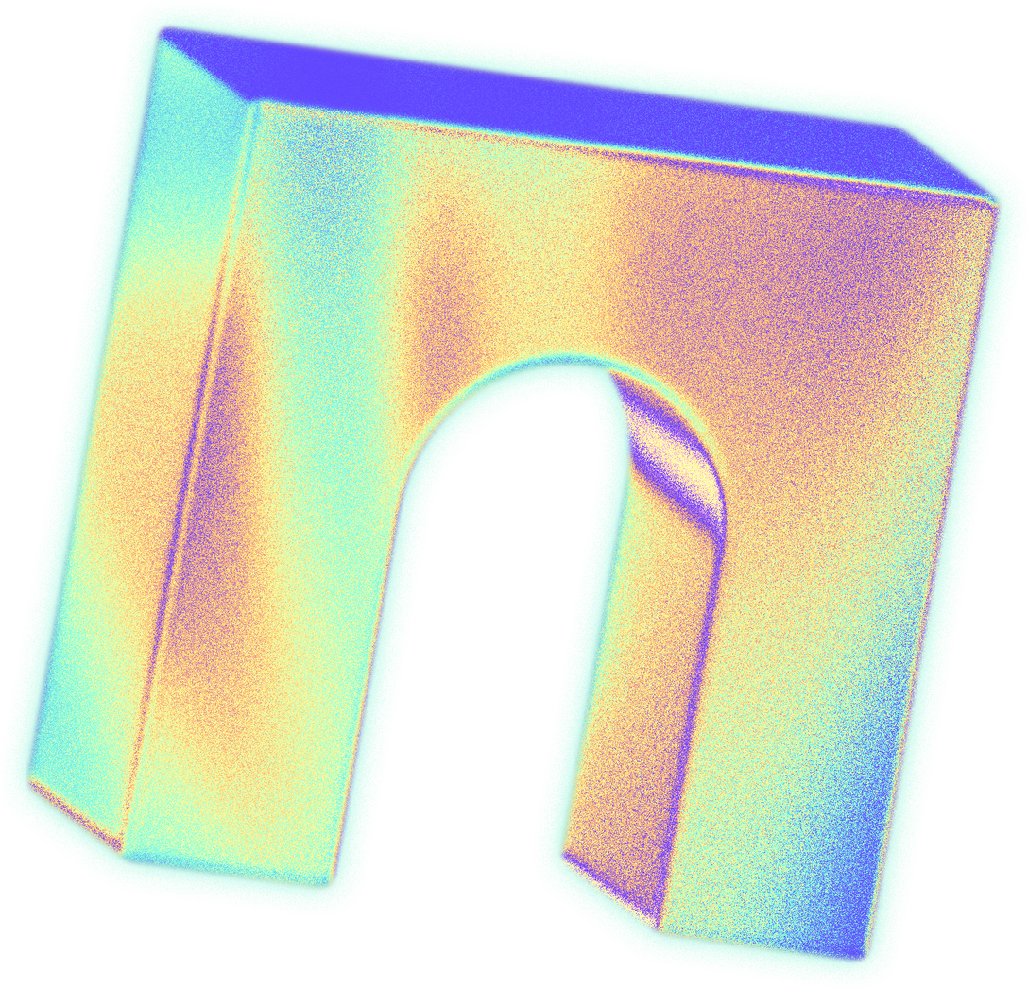

THE
PROBLEM
Bias and corruption among moderators lead to power imbalances and a "MOD IS GOD" scenario in an otherwise democratic setting
Centralized moderation is susceptible to bias, whether unintentional or systematic, leading to uneven enforcement of guidelines.

Slide 5
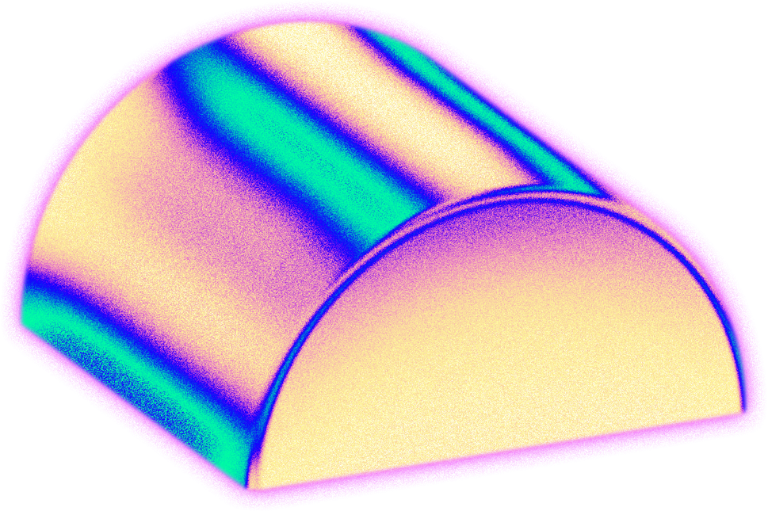
As user-generated content volume grows, centralized systems struggle to moderate effectively without significant delays or overlooking harmful content.
The absence of clear moderation logic and appeal processes leads to user frustration and diminished trust in the platform.

Slide 6


THE
SOLUTION
Empowering Users: DeMod shifts content moderation power to platform users, ensuring a fair and decentralized approach.
Incentivized Moderation: Users moderate flagged content and earn tokens and cryptocurrency, incentivizing active participation and quality control.
VISION
MISSION
To decentralize content moderation as we know it
To transfer the power to the people .
Provide a safe, scalable moderation service that is at par with the web3 landscape.
Build a community that respects freedom of speech

Slide 7
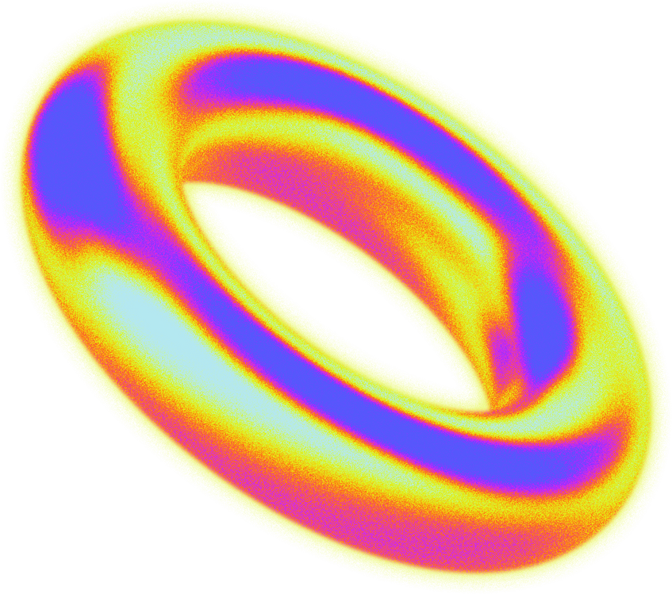
Cost-Efficient Solution: Content-based enterprises benefit from outsourcing moderation tasks, saving time and resources, while maintaining quality standards.
Win-Win for Stakeholders: DeMod ensures user satisfaction with increased control, while businesses optimize efficiency and reduce expenses, fostering a mutually beneficial ecosystem.

Slide 8
THE
SERVICE
Its a website or an extension to an existing app where users create an account(we will use zero knowledge proofs for this) .
They can start voting on whether a post should be removed or not, these votes will be considered based on a reputation system i.e higher the reputation more the percentage of vote power(0.05% to 0.8%).

Slide 9
As the reputation increases, the user will be allowed to vote on other users getting banned and so on.
The more they vote, the more reputation points recieved and hence more tokens they receive.

Slide 10


THE
MARKET ANALYSIS
The global content moderation solutions market was valued at USD 9.02 billion in 2022.
It is expected to reach USD 15.65 billion by 2028, growing at a CAGR of 9.62% [Source: Industry Research].

Slide 11
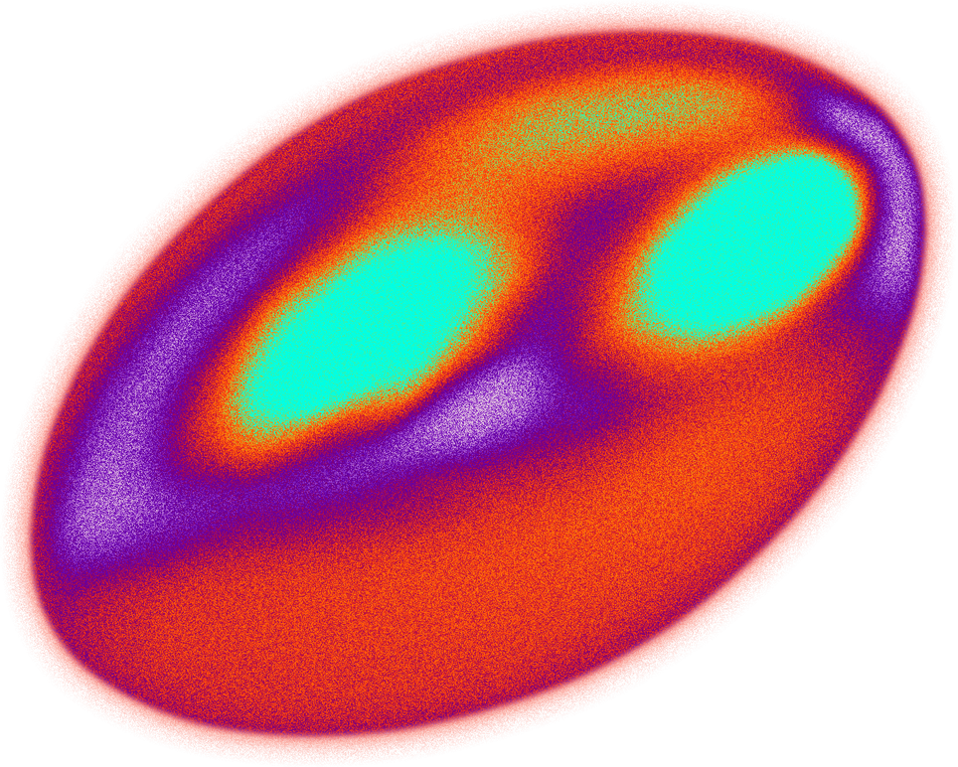

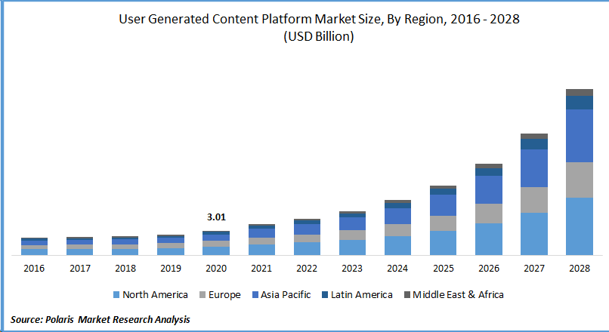
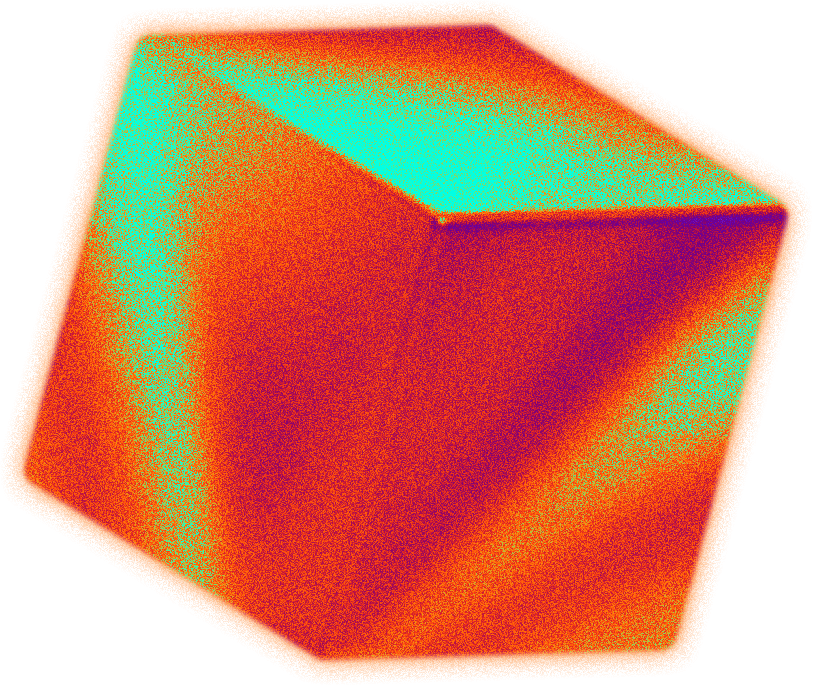
The amount of user-generated content (UGC) on social media platforms will grow by 22.5% annually through 2027 [Source: Statista]. This rising UGC volume fuels the demand for efficient moderation .
Concerns about online safety, misinformation, and brand reputation are driving businesses to explore innovative solutions like user-driven moderation

Slide 12
HOW WE MAKE MONEY?
DeMod aims to be a business to business (B2B) service based company, that provides moderation services to our clients.
THE
BUSINESS
MODEL
WHY USERS COME TO US?
We plan on providing monetary incentives in the form of tokens that will further integrate with the blockchain and result in a crypto currency for our users.

Slide 13

THE
POTENTIAL PARTNERS
TWITTER
YOUTUBE
REDDIT
INSTAGRAM
WIKIPEDIA
QUORA

Slide 14

THE
TECH STACK
GOLANG
SOLIDITY
SUPABASE
TAILWIND CSS
COMPANY TECHSTACK

Slide 15
THE
REFERENCES
https://www.linkedin.com/pulse/text-content-moderation-solution-market-size-share
https://embedsocial.com/blog/ugc-statistics/
https://ethereum.org/en/zero-knowledge-proofs/#how-do-zero-knowledge-proofs-work
https://medium.com/coinmonks/zk-starks-create-verifiable-trust-even-against-quantum-computers-dd9c6a2bb13d
Write a short statement about the consumer's assessment of your product.

Slide 16
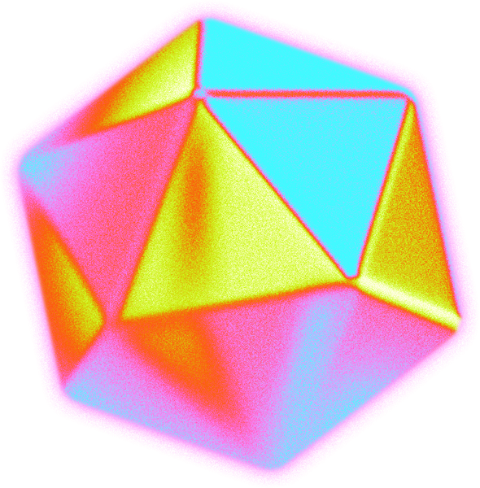
ANIL
PRANAV
THE
TEAM
PRANAY
ANAY

Slide 17
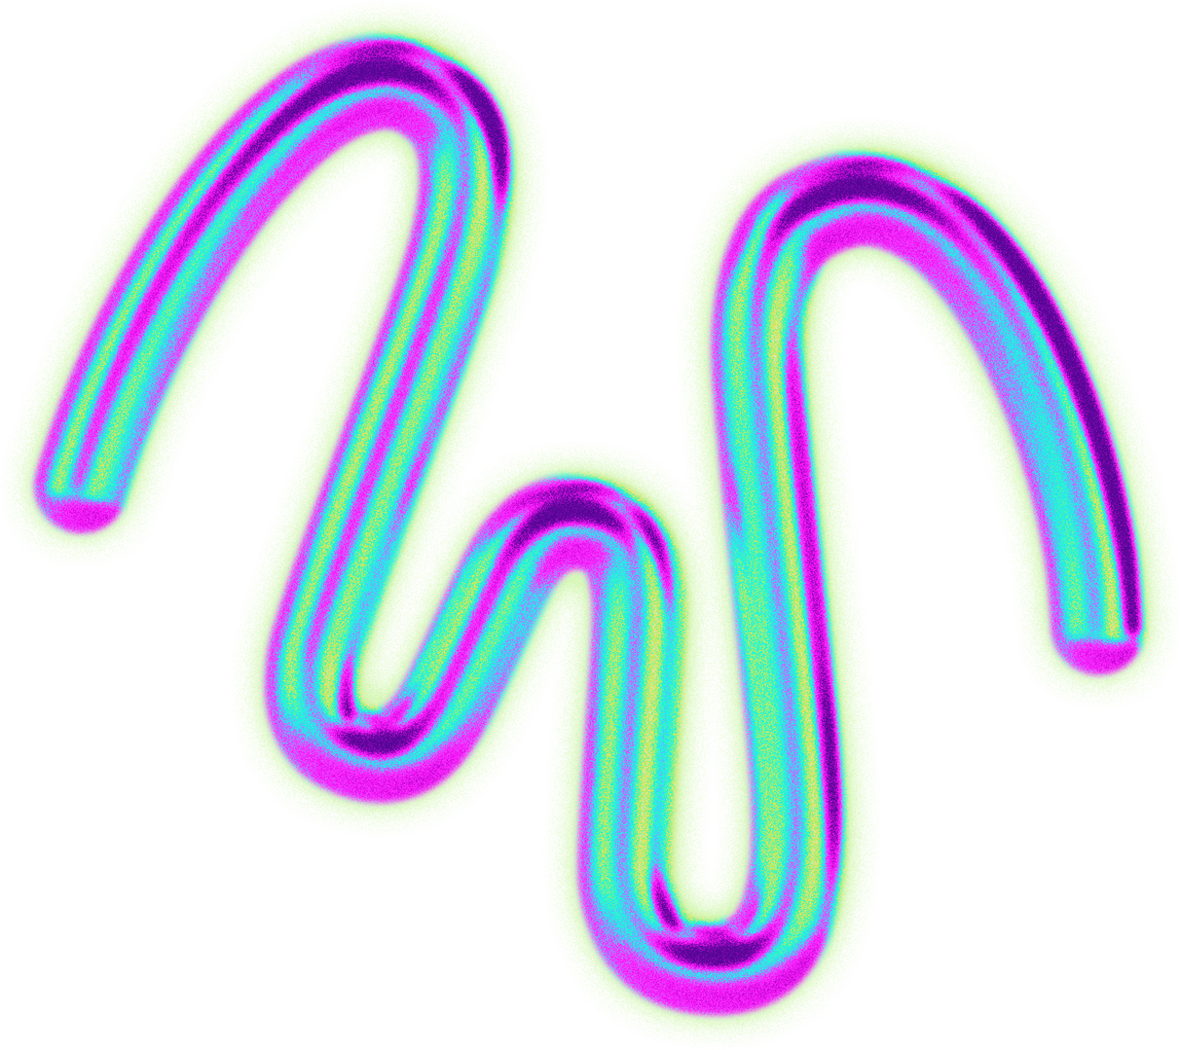

THANK YOU

